Slide 1
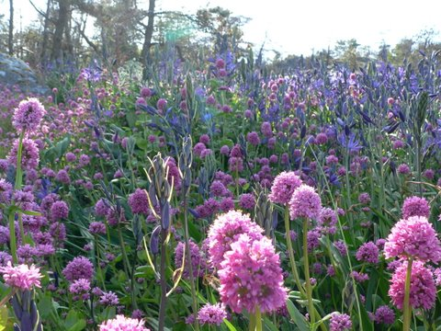

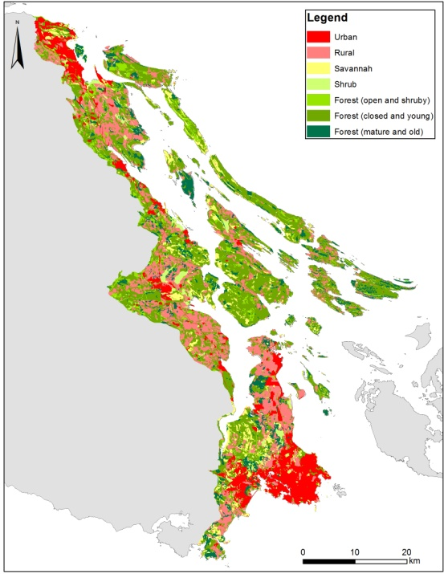
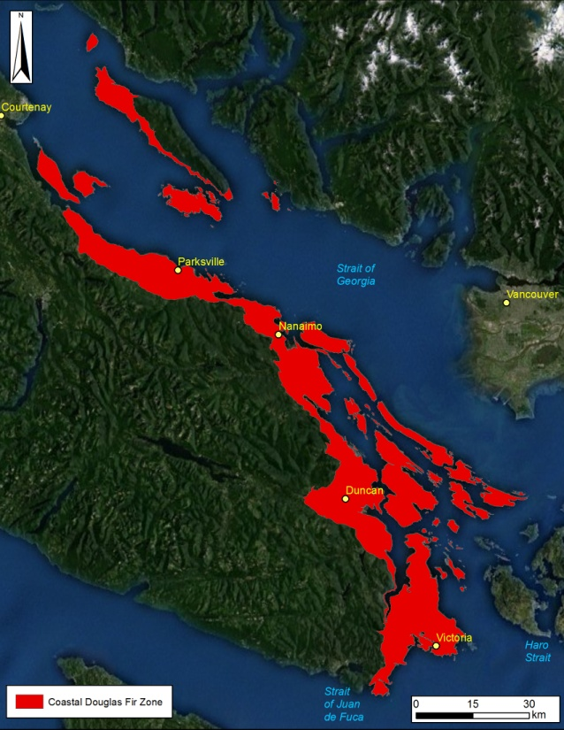
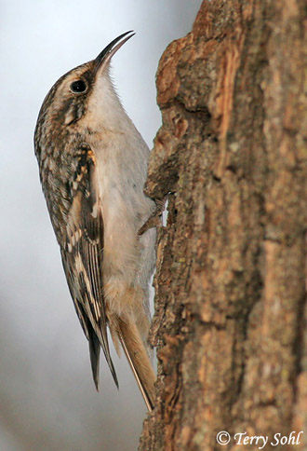
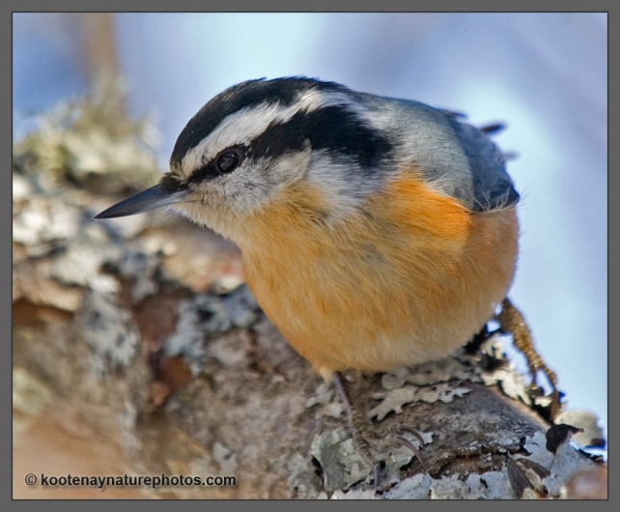
Marxan and Relatives
Richard Schuster
Liber Ero Fellow
Geomatics and Landscape Ecology Lab
Carleton University

Slide 2
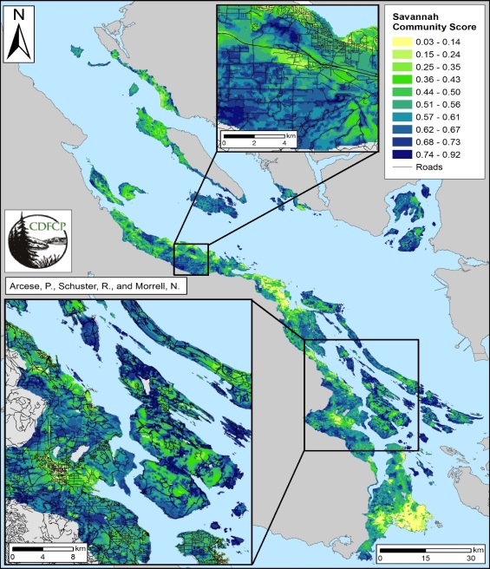
SMD’s as biodiversity features
Point count data
Landscape variables
47 spp
Composite maps:
OF, SAV, SHR, WET, HUM

Slide 3
How can we combine all this information in a meaningful way for conservation?
Decision support tools: Marxan
Planning units (e.g. properties, watersheds, hexagons, …)
Species or Feature targets (e.g. protect 20% old forest, …)
Create compact reserve systems to reduce e.g. edge effects

Slide 4
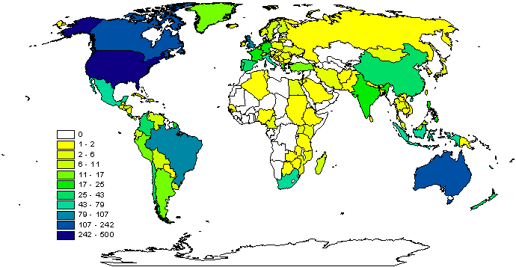
Why Marxan?
Aids systematic reserve design for conservation planning
Near optimal spatial reserve systems
Most widely used systematic reserve planning software in the world.
Contributes towards a transparent, inclusive and defensible decision making process.
2009

Slide 5
What can Marxan do?
Identify areas that meet targets for a range of input features for minimal cost
Uses concept of complementarity (Select new conservation areas so that each one complements the others in the biodiversity features they contain)
Can maximise compactness
Can include data on ecological processes, threats, and condition
Decision-support, not a decision-maker

Slide 6
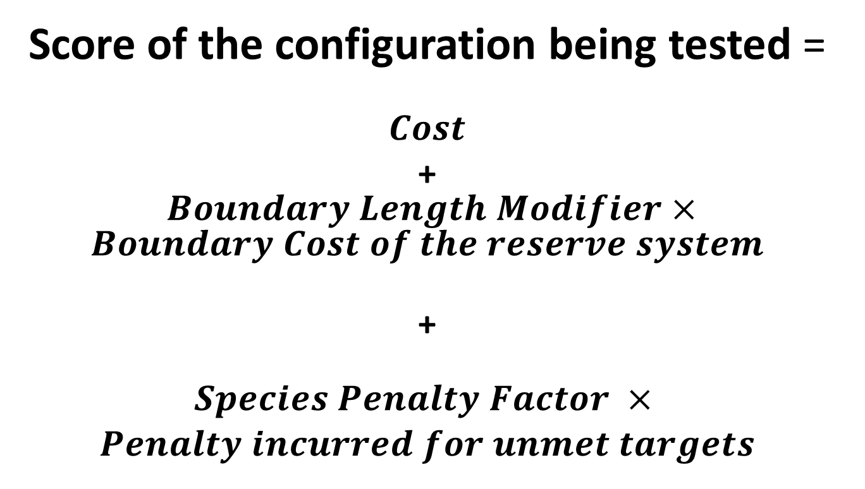
What problem does Marxan solve?
Score of the configuration being tested =
$$Cost$$
+ $Boundary Length Modifier×Boundary Cost of the reserve system$
+
$$\begin{aligned}Species Penalty Factor × \\ Penalty incurred for unmet targets\end{aligned}$$

Slide 7
The “minimum set” conservation planning problem
Minimise the overall “cost”
Subject to the “constraint” that all biodiversity targets are met (e.g. 20% of each vegetation type)
Given data on distributions of biodiversity features and the cost of each planning unit
Every planning unit can be either prioritised for investment or not (this is what we control)

Slide 8
Mathematical Formulation
m Minimise ∑c _{j} x _{j} + α.BoundaryLength j=1 n Subject to ∑ ªij ^{x} j ^{≥ 1 i = 1,K , m} j =1 x_{j} ∈{0,1} a_{ij} =amount of feature i in planning unit j x _{j} = 1 if the planning unitis in the reserve system

Slide 9
Key data requirements
Boundaries of the planning region
Biodiversity features
Planning units
Data matrix (features X planning units)
Cost of each planning unit

Slide 10
Planning unit Cost
Area (of planning unit or of available habitat)
Financial value
Opportunity cost
Potential profitability

Slide 11
Boundary cost
The total amount of edge that the planning units share with unprotected units
Cost = length of edge (or dollars)
Marxan multiplies by the Boundary Length Modifier (BLM)
Increasing the BLM increases the cost of having a fragmented set of conservation areas.

Slide 12
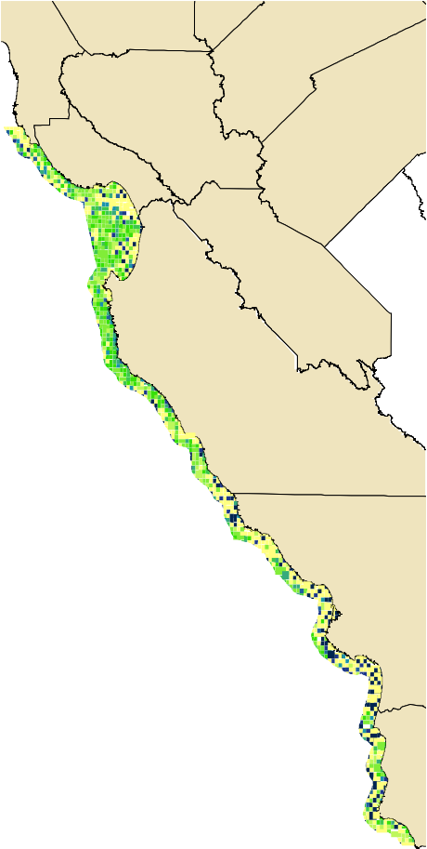
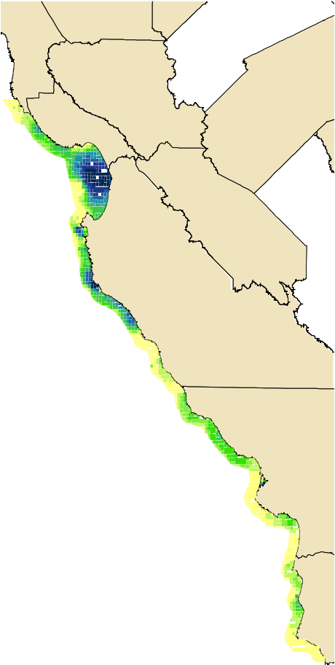
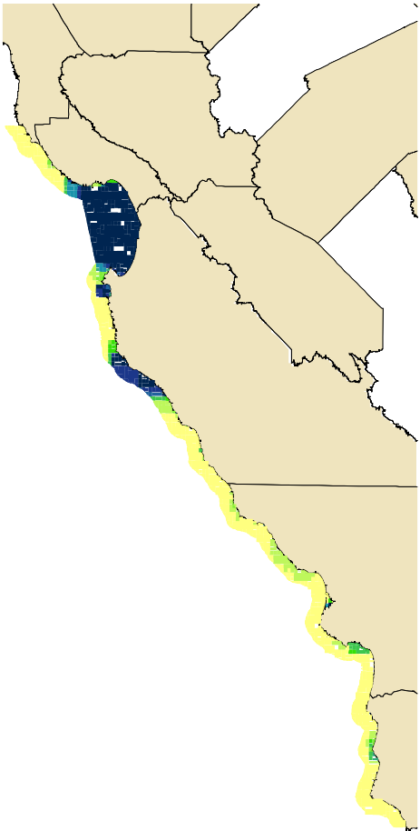
Spatial Compactness of Reserves
Planning Unit Inclusion
0 - 10
11 - 20
21 - 30
31 - 40
41 - 50
51 - 60
61 - 70
71 - 80
81 - 90
91 - 100
¯
0 10 20 40 60 80
Miles
a. BLM = 0
b. BLM = 0.0001
c. BLM = 1
BLM = Boundary Length Modifier

Slide 13
Tradeoffs – Area/Cost vs Boundary
2500
2000
BLM = 0
Boundary Length (km)
1500
1000
BLM = 0.0001
500
BLM = 1
0
850
900
950
1000
1050
1100
Area (km²)

Slide 14
Species Penalty Factor
Marxan calculates whether the target for each conservation feature is met and includes a cost for any target that has not been meet (as specified by the species penalty factor).
These penalty factors can be generic or species specific (currently only generic included).

Slide 15
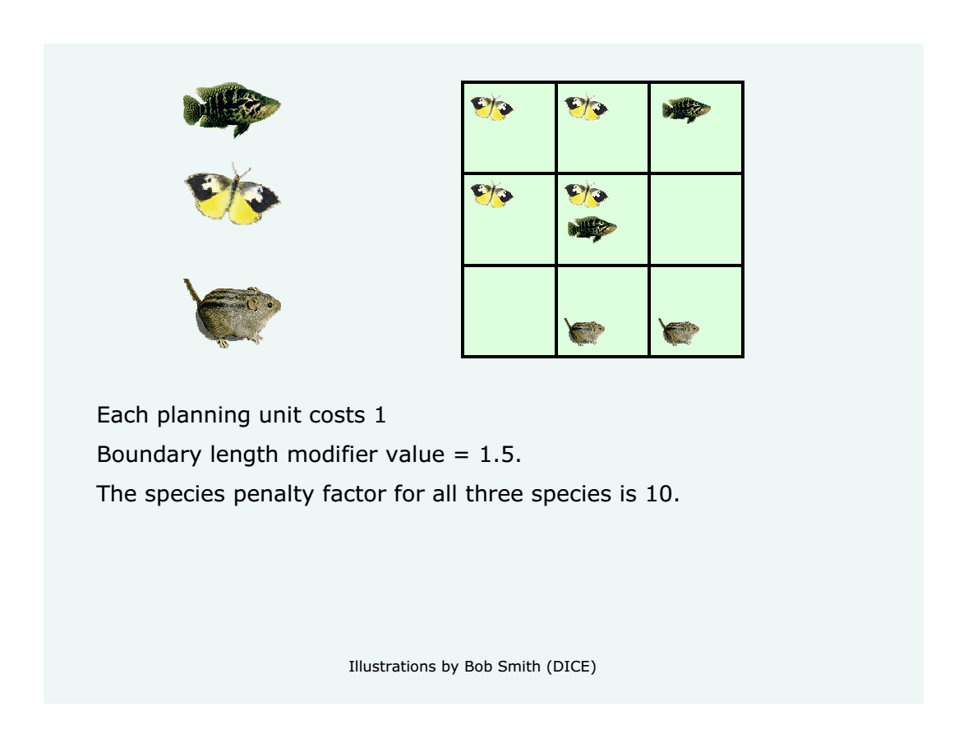

Slide 16
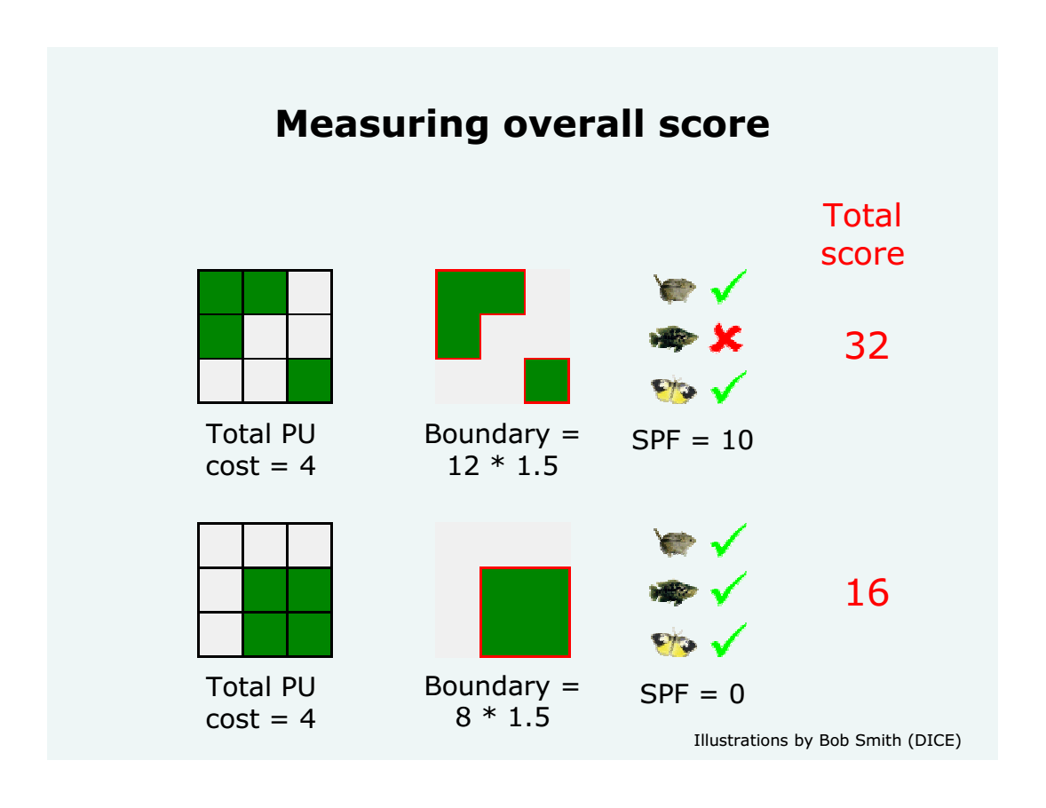
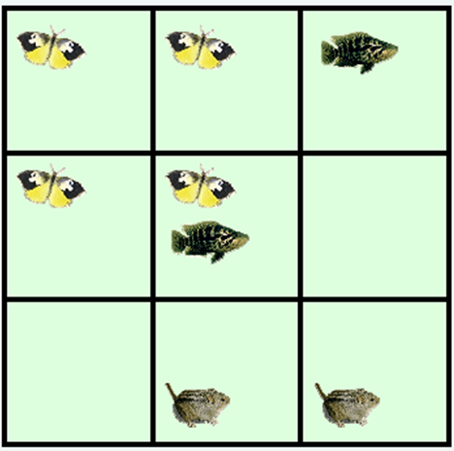

Slide 17
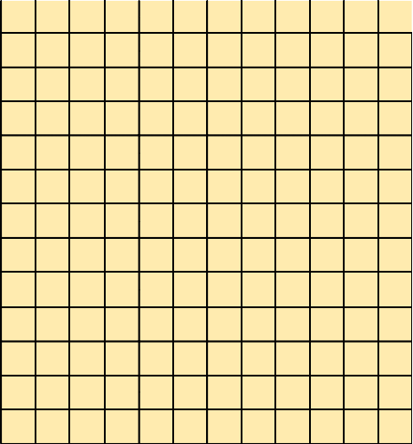
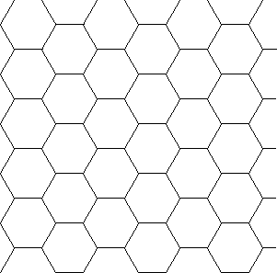
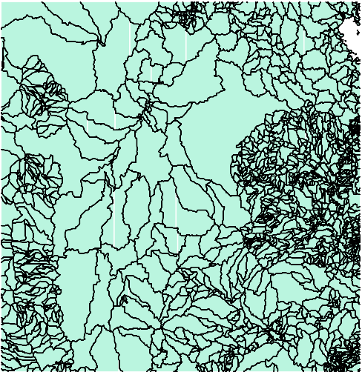
Planning Units
Grid
Hexagons
Environmental Units
There are various ways of creating planning units

Slide 18
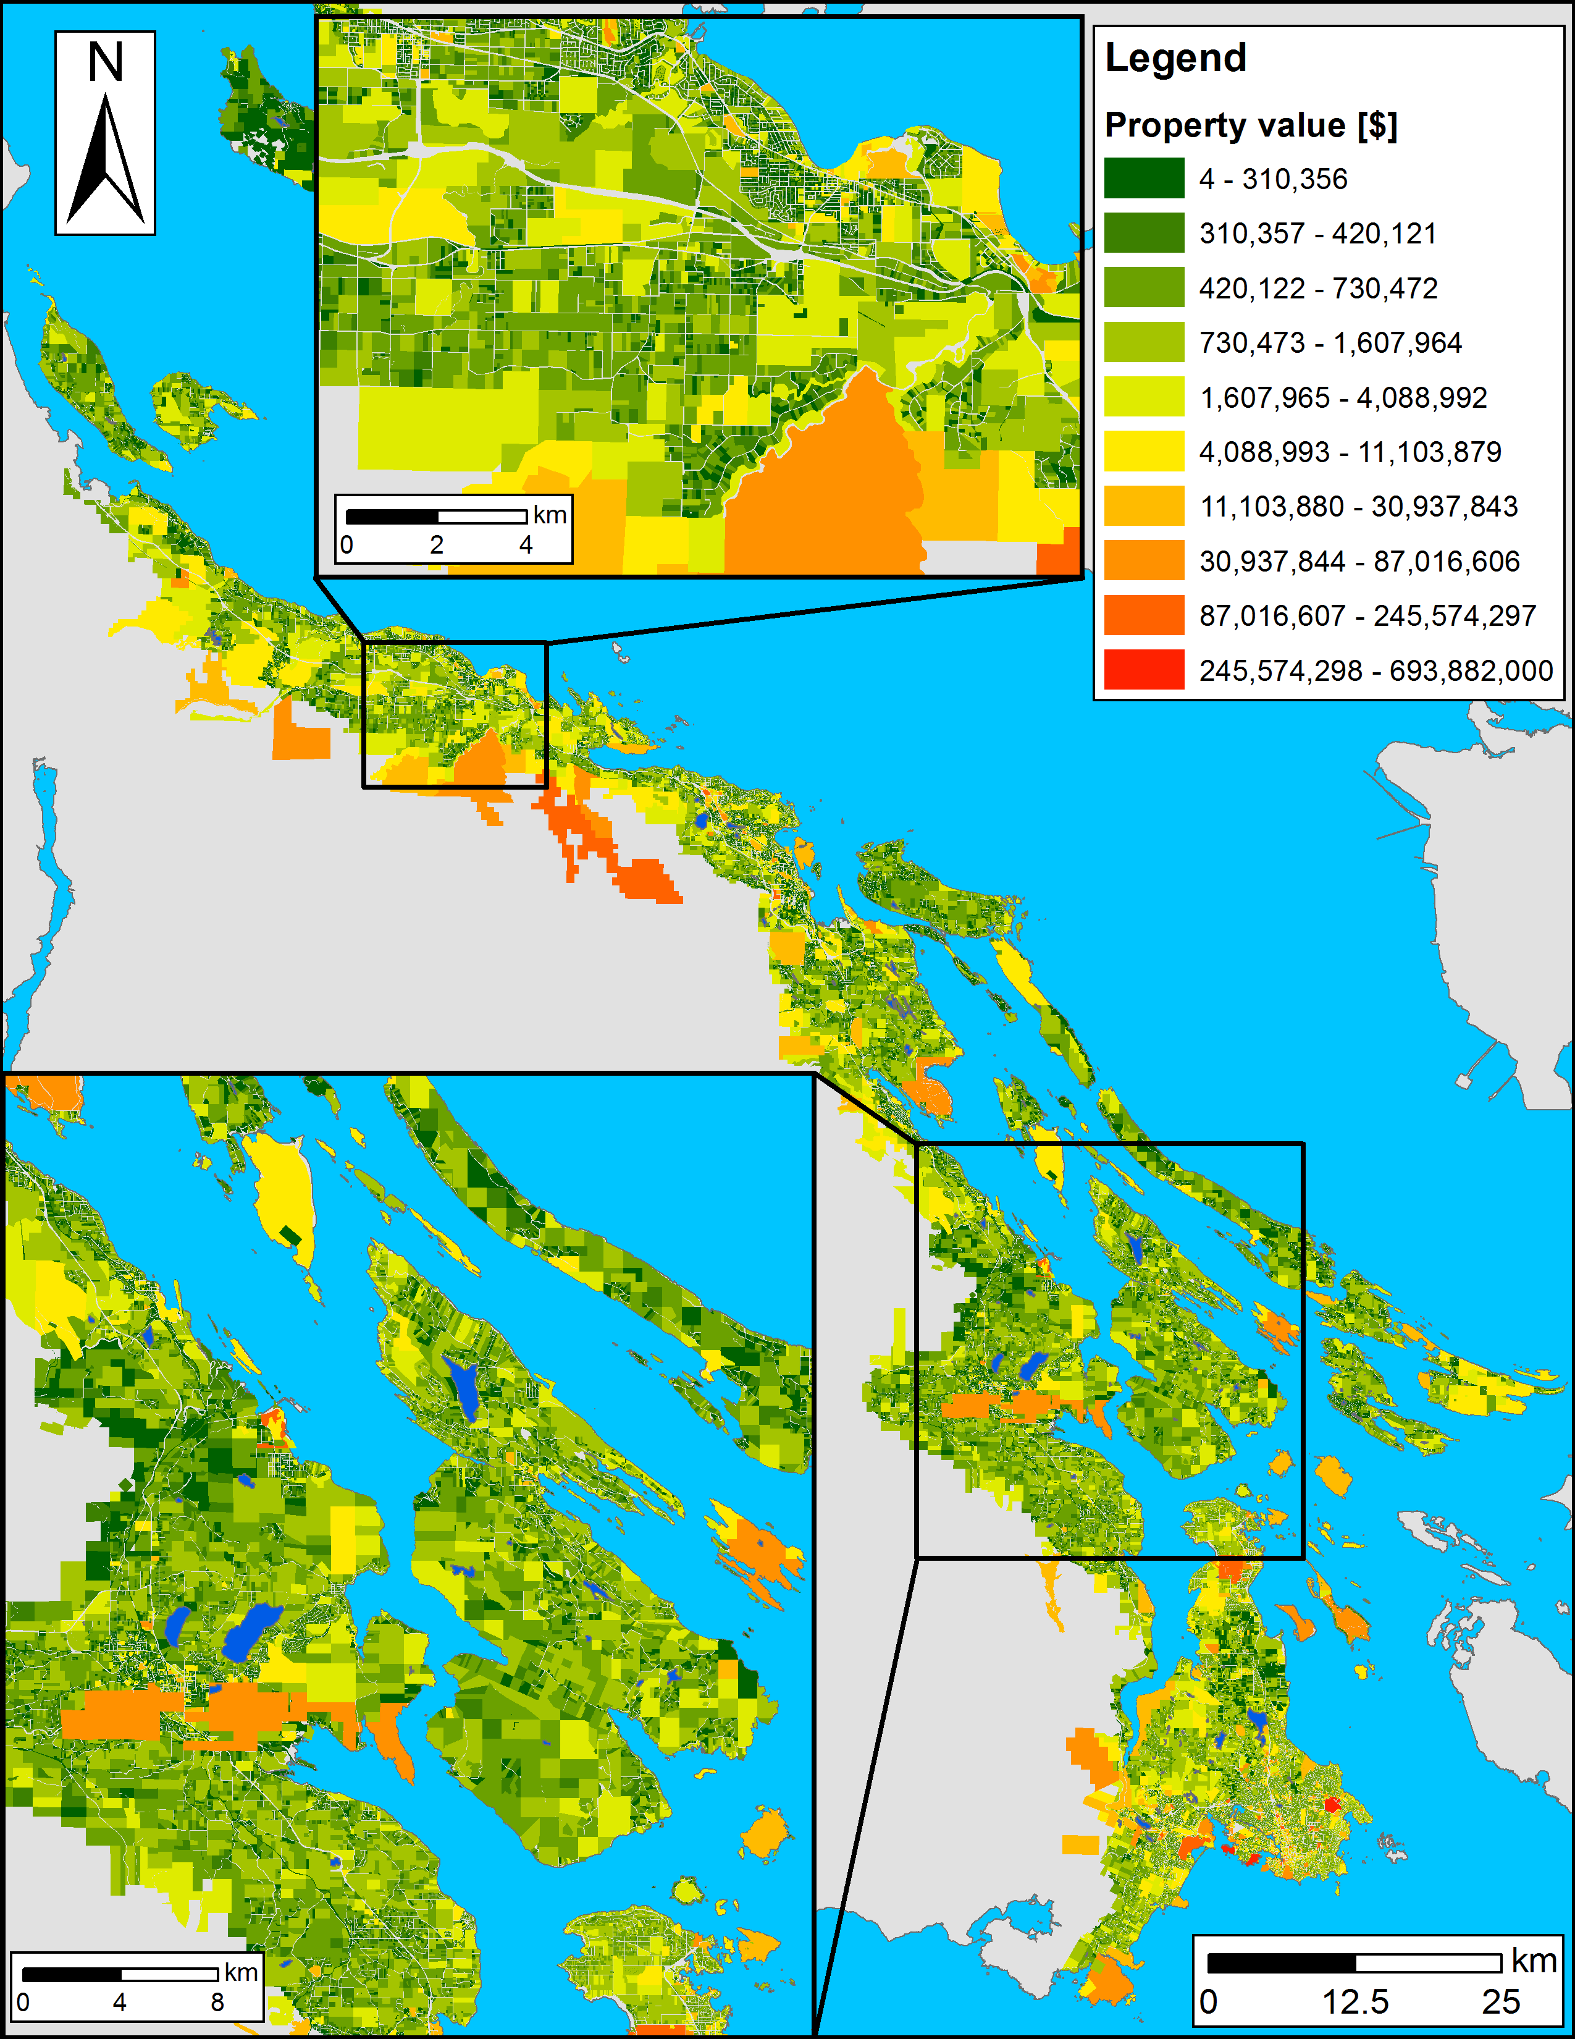
Planning units
Land base of the CDFCP: ~198,000 properties
Possible solutions for a reserve system: 2^198,000 > atoms in the Universe
How to optimize prioritization? Simulated Annealing

Slide 19
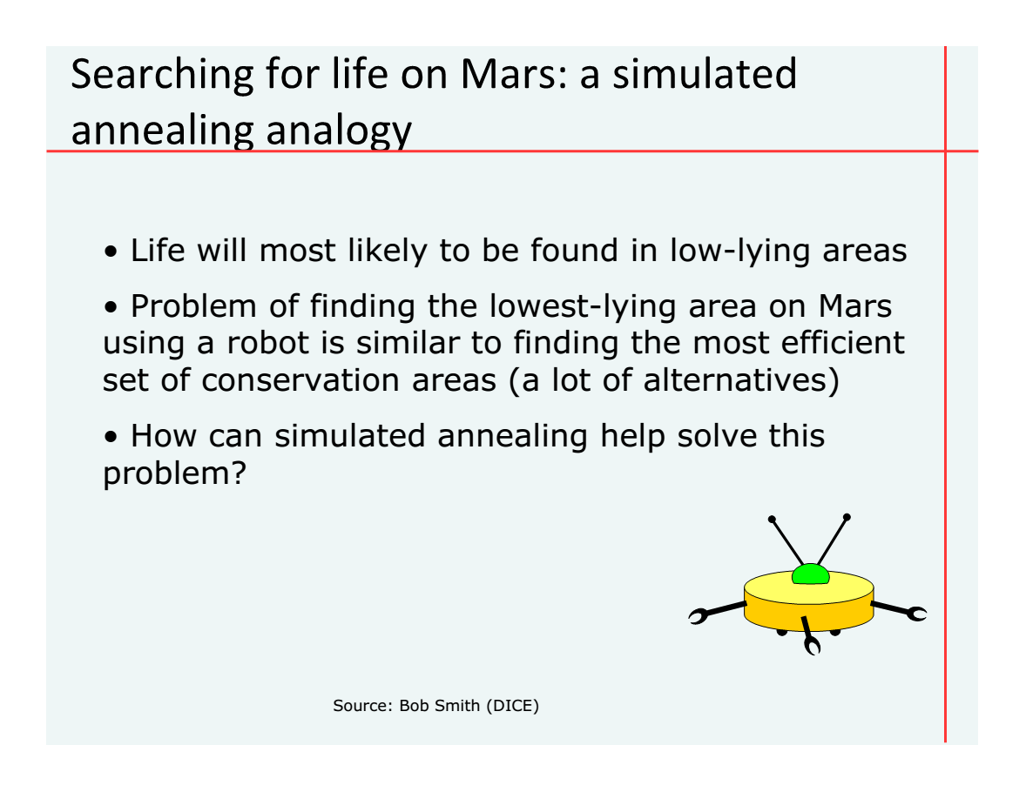

Slide 20
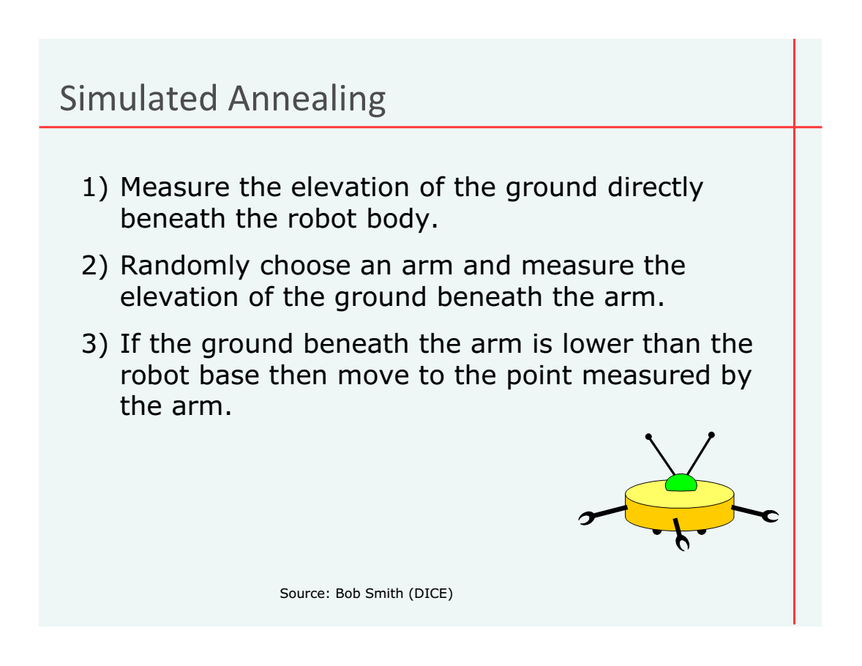

Slide 21
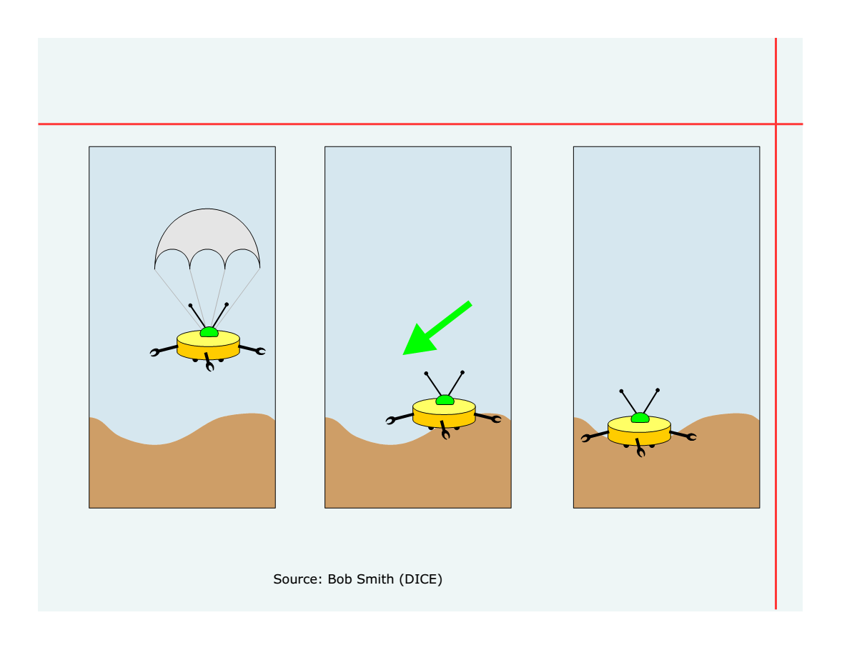

Slide 22
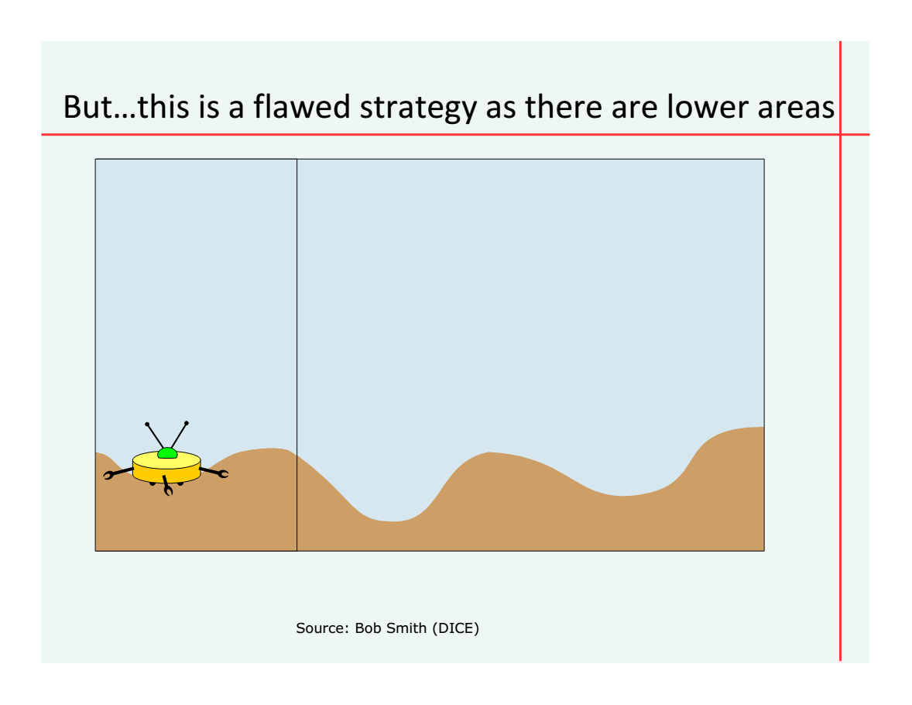

Slide 23
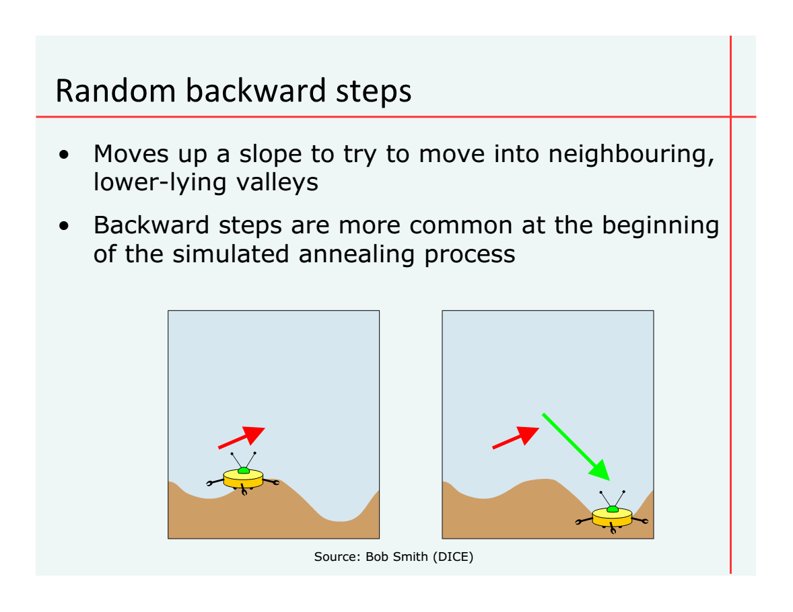

Slide 24
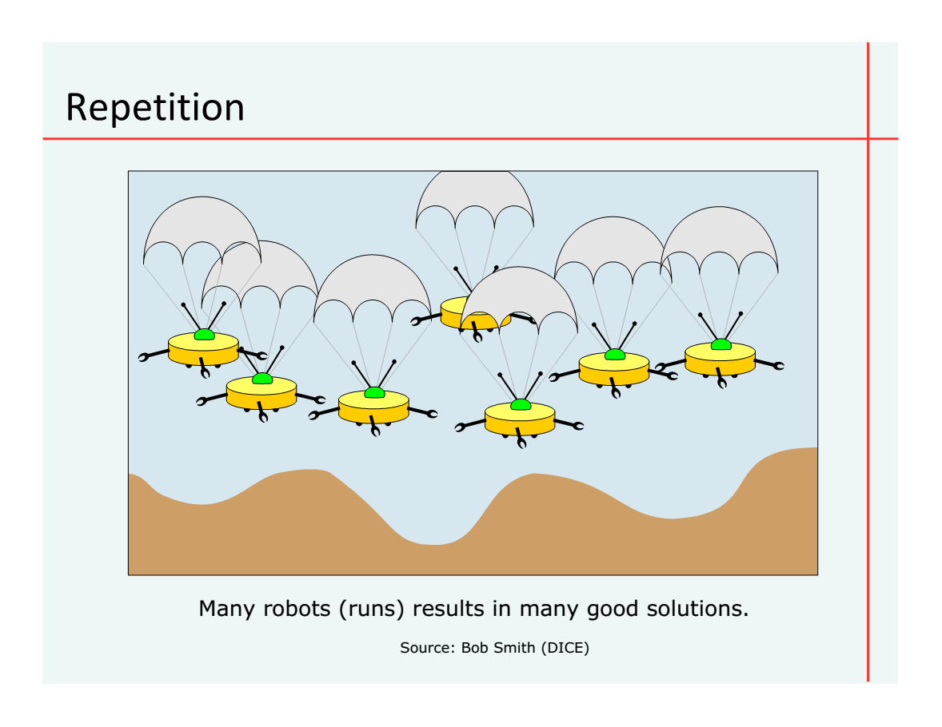

Slide 25
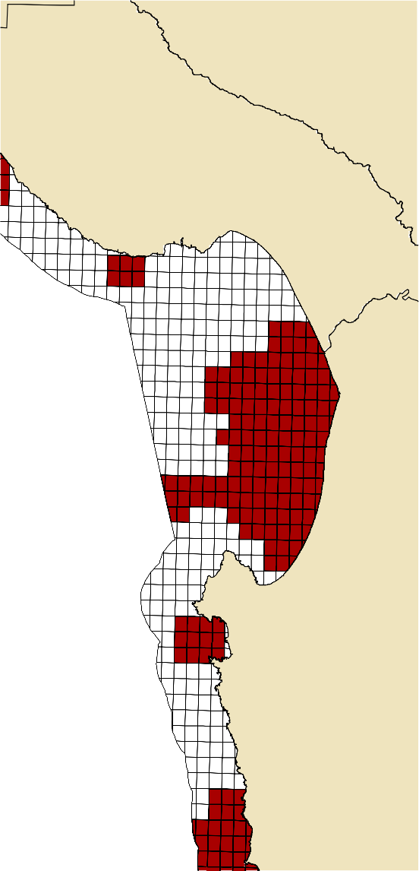
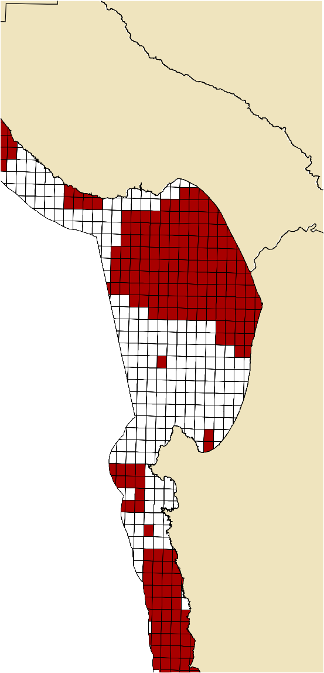
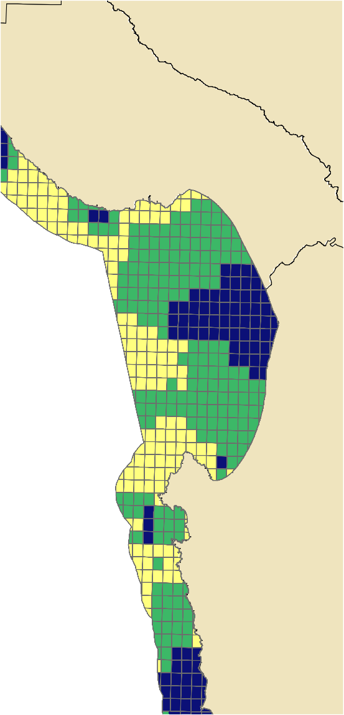
Individual
Summed Solutions
Solution 2 Summed Solution
Solution 1
+
=
100 Individual Runs

Slide 26
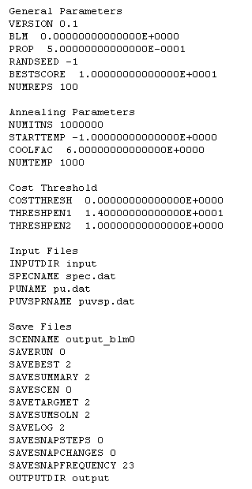
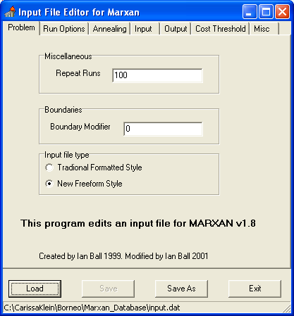
Input file

Slide 27
Parameter Setting
Some you will need to set: Runs (restarts of the program) Iterations (number of times Marxan tries to find a good solution) BLM Some are standard: Temperature settings Annealing parameters Program controls

Slide 28
Improvements in user interface
Multiple scenarios
Calibration tool (SPF, BLM, # iterations)

Slide 29
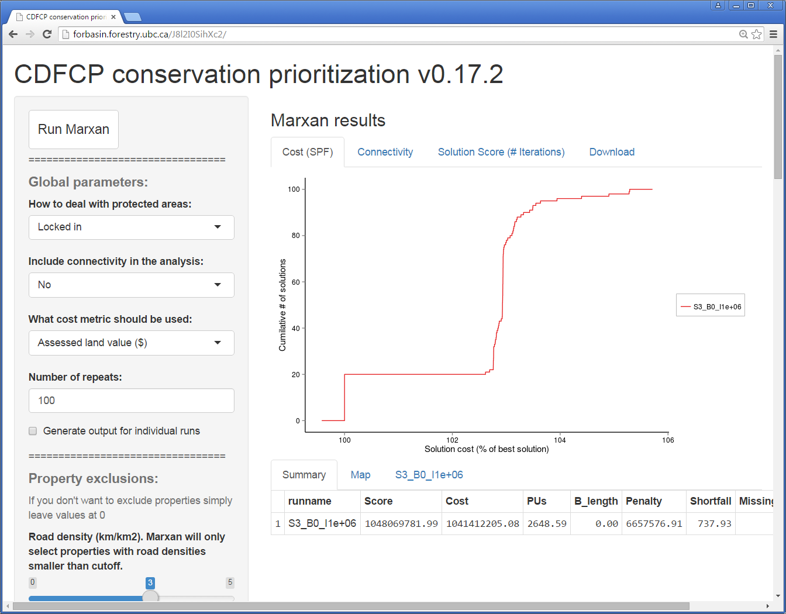

Slide 30
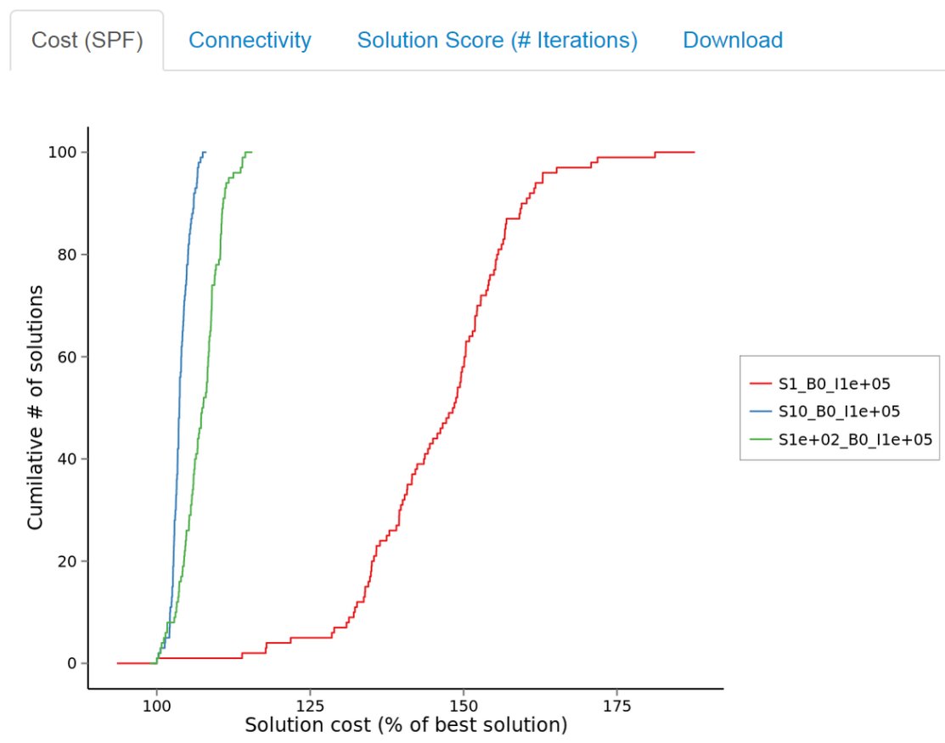
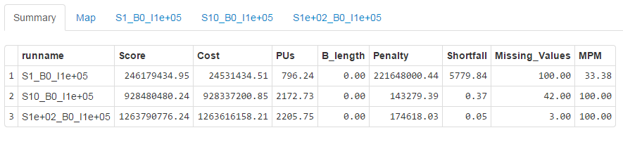
Output figures
Mostly for calibration
SPF + MPM
Notes:
Cumulative distribution curve/function

Slide 31
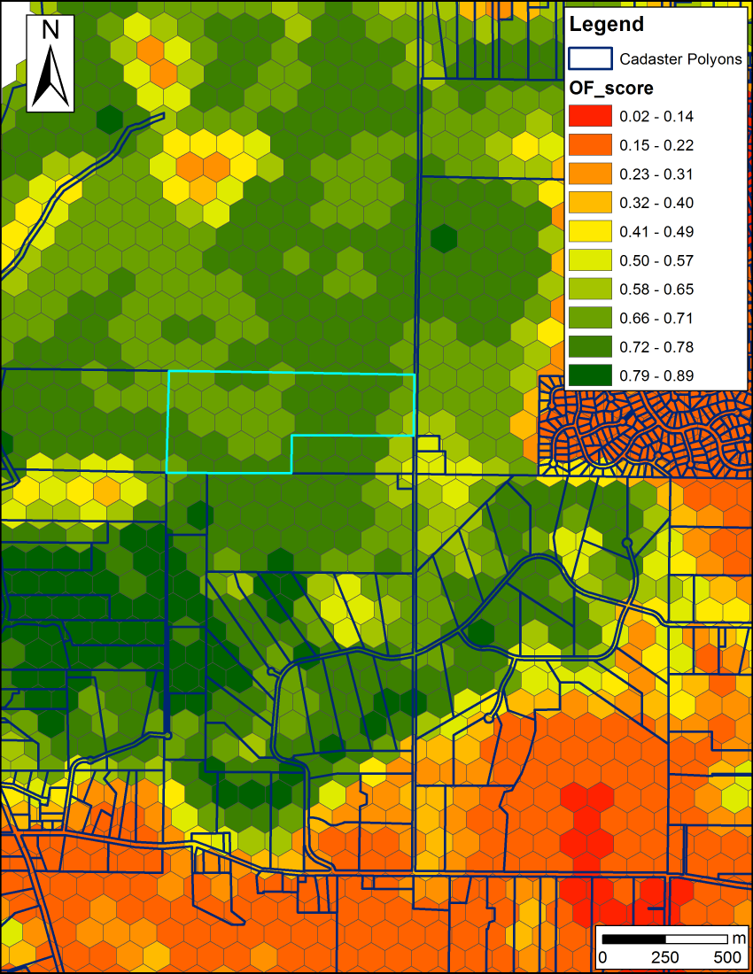
Marxan using simulated annealing
10 Biodiversity features/ constraints
Protect X% of each
Planning units
Cadastral data (198k parcels)
Minimize cost ($)

Slide 32

Integer Linear Programming

Slide 33
No more calibration necessary
BLM type approach in paper, but not included in tool (yet)

Slide 34
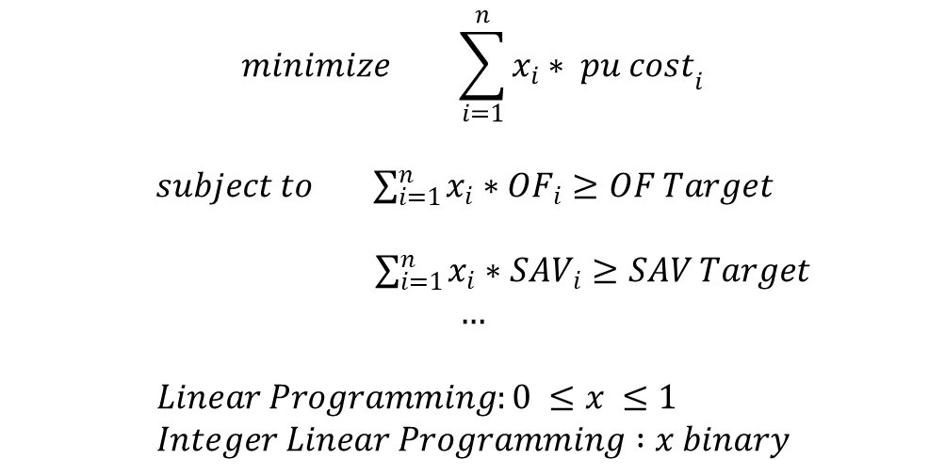
Scaling up
Local (CDFCP)
Regional
(NPLCC)
Planning units
198k
2.4M
Time to run
Marxan
5 min
2 days
Tim
e to run LP*
10 sec
3 min
Solution: Linear Programming
$$minimize \sum_{i=1}^{n}{x_{i}∗ {pu cost}_{i}}$$
$subject to \sum_{i=1}^{n}{x_{i}∗{OF}_{i}}≥OF Target$
$\sum_{i=1}^{n}{x_{i}∗{SAV}_{i}}≥SAV Target$
$$…$$
$$Linear Programming:0 ≤x ≤1 \\ Integer Linear Programming :x binary$$
*Using Gurobi

Slide 35
Gurobi vs Open Source
6 constraints
pu's | Gurobi (ILP) | lpSolve | Rglpk | Rsymph LP (ff) | clpAPI (LP) | lpSolveAPI
1k | 0.028 | 0.256 | 0.955 | 0.008 | 0.002 | 0.028
10k | 0.206 | 2+h (canceled) | 200 | 0.244 | 0.225 | 1.92
100k | 5.14 | - | 820 | 32.85 | 35.38 | 200 (limit)
1M | 42.51 | - | 11300 | 5078 | 5100 | 2000 (timed out)

Slide 36
But, speed is really just a side benefit
Marxan = near optimal solution
ILP = optimal solution
As an example for the CDF:
Preliminary scenario for tax shifting paper
Marxan solution cost $229 million
ILP solution cost $151 million
34% reduction in cost

Slide 37
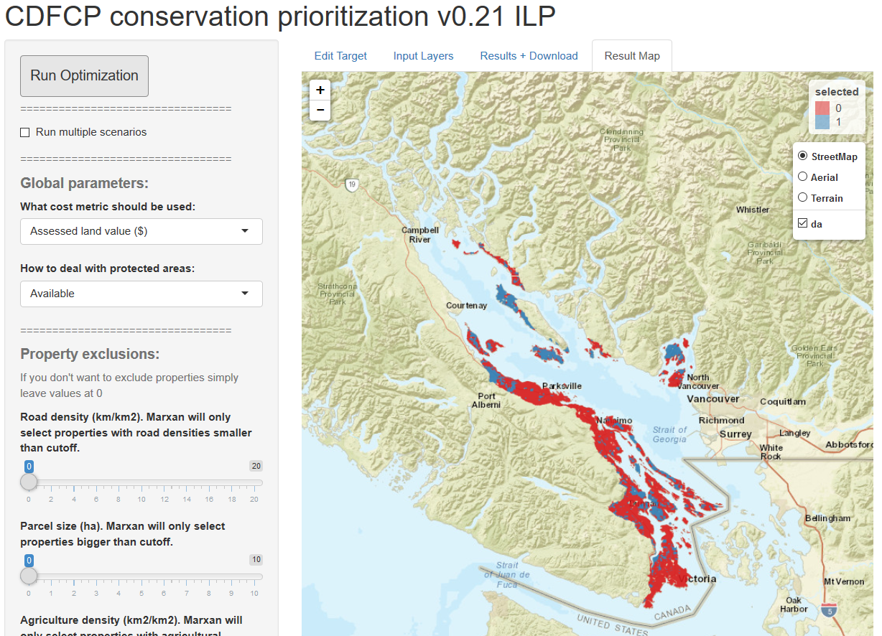

Slide 38
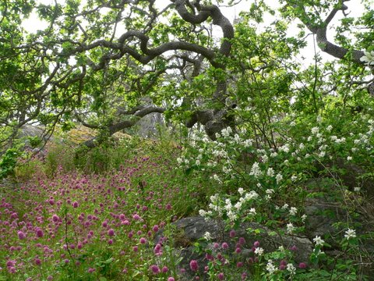


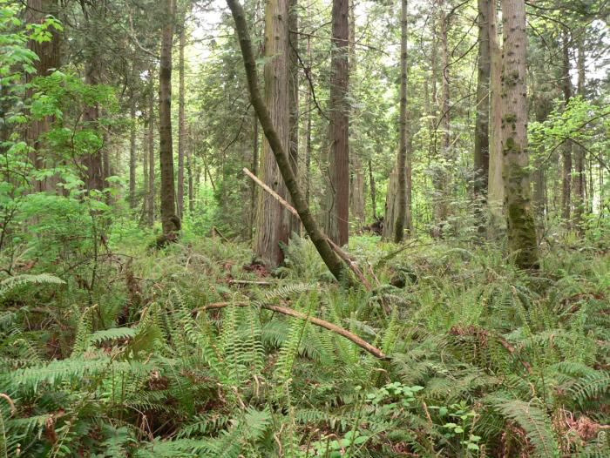

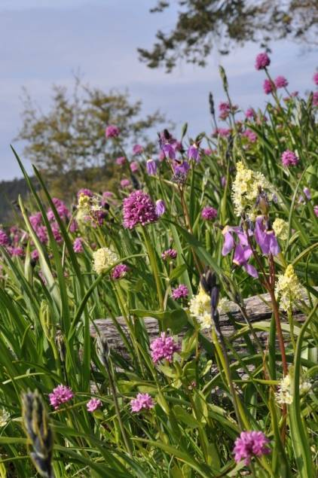
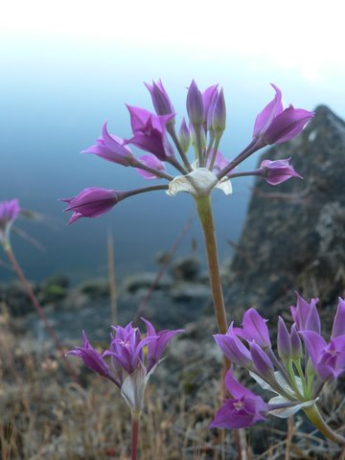
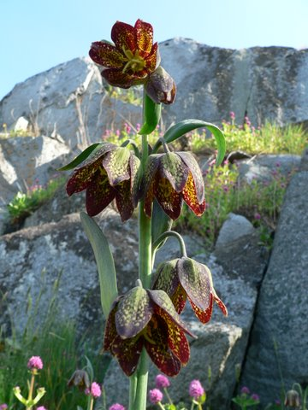



Thank you
Notes:
38

